Slide 1
RAIL-GUARD
Catching the Bolt before it Breaks
A Vibration-Based Early-Warning System for Railway Fishplate Joints
fishplate joint · 8 bolts
Mohit Sheth · Dhirubhai Ambani International School, Mumbai · DAIS × OMOTEC 2026–27
Notes:
Good morning. Right now, somewhere in India, a railway worker is walking down a track in the heat, tapping bolts one by one with a hammer. My project is about making that job smarter and safer. It's called Rail-Guard — a system that catches a failing bolt before it breaks.

Slide 2

The Problem Statement
1
A Fishplate Joins/Connects Two Rails
Two steel plates + 8 bolts -> hold the rail ends together.
2
Trains Vibrate -> Bolts Loose
Every passing train slowly works the bolts loose over time.
This can cause train derailment.
3
Inspectors Check each Bolt by Hand
fishplate joint · 8 bolts
A worker walks the line and hammers every bolt, listening for loose ones.
Notes:
First, what are we even looking at? Where two rails meet, they're held together by a steel plate called a fishplate — bolted on with eight bolts per joint. Every time a train passes, the vibration loosens these bolts a tiny bit. Over time, they work loose. The way we find them today hasn't really changed in decades — an inspector walks the line and taps each bolt with a hammer, listening for the dull sound a loose one makes.

Slide 3
The Inspection Process is Lengthy and Ineffective
~69,000 km
4–6 km
By hand
India's rail network (2024)
walked per inspector, daily, on foot
every bolt tapped, one by one
An inspector checks each bolt individually
Notes:
Here's the scale of it. India's rail network is about sixty-nine thousand kilometres. Every inch of it is checked by inspectors walking a three-to-eight kilometre beat on foot, tapping every bolt by hand. And here's the real problem — it's blind. The inspector has no way of knowing which bolt is loose until he's already standing on top of it. He checks thousands of perfectly fine bolts to find the one that isn't.

Slide 4
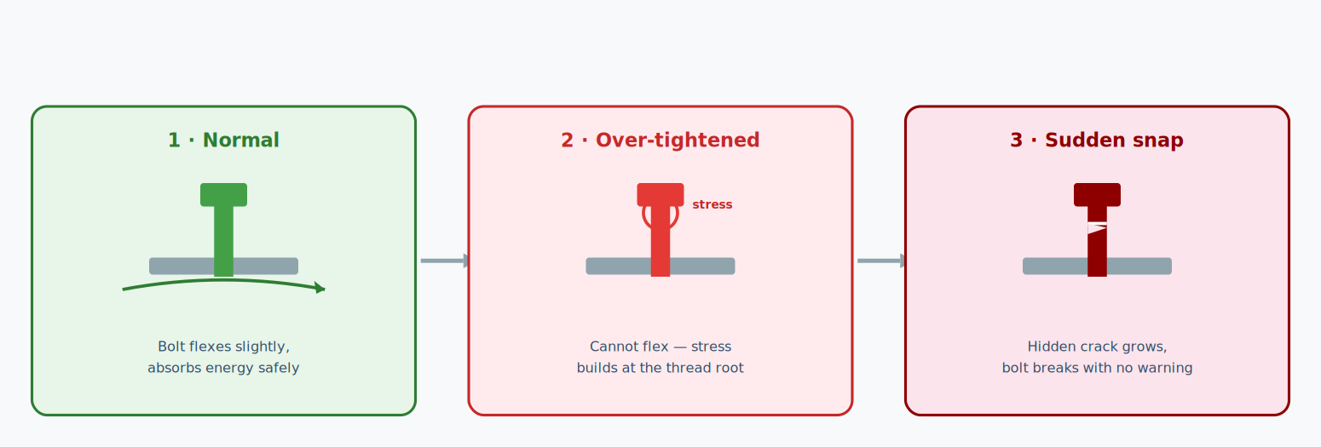
Loose isn't the only Failure
An over-tightened bolt shows no problem — the pressure builds up until it snaps with no warning.
Notes:
There's also a second failure that almost nobody talks about — over-tightening. When a worker tightens a bolt too hard, the joint can't flex anymore. Stress builds up at the thread, tiny cracks form that you can't see, and then the bolt snaps suddenly, with no warning at all. A loose bolt at least gives you a sign. An over-tightened one looks perfect — right up until it fails. No current inspection method can catch it. Mine can.

Slide 5
This isn't Theoretical
!
!
!
Hazara Express
Kavaraipettai
Surat
Pakistan · 2023
Tamil Nadu · 2024
Gujarat · 2024
Derailment, 30+ deaths. Official inquiry blamed missing fishplates and a broken rail.
Derailment. Railway probe found missing nuts and bolts at the accident site.
Loosened fishplate bolts on the track — spotted by an alert inspector just in time.
Dawn, 2023
The Week, 2024
Deccan Herald, 2024
Notes:
And this isn't theoretical. In 2023, the Hazara Express derailed in Pakistan — over thirty people died, and the official inquiry blamed missing fishplates and a broken rail. In 2024, in Tamil Nadu, a railway probe into a derailment found missing nuts and bolts right at the accident site. And also in 2024, in Surat, someone loosened fishplate bolts on a track — it was caught only because one inspector happened to spot it in time. The system relies on luck and human alertness. That's the gap I want to close.

Slide 6
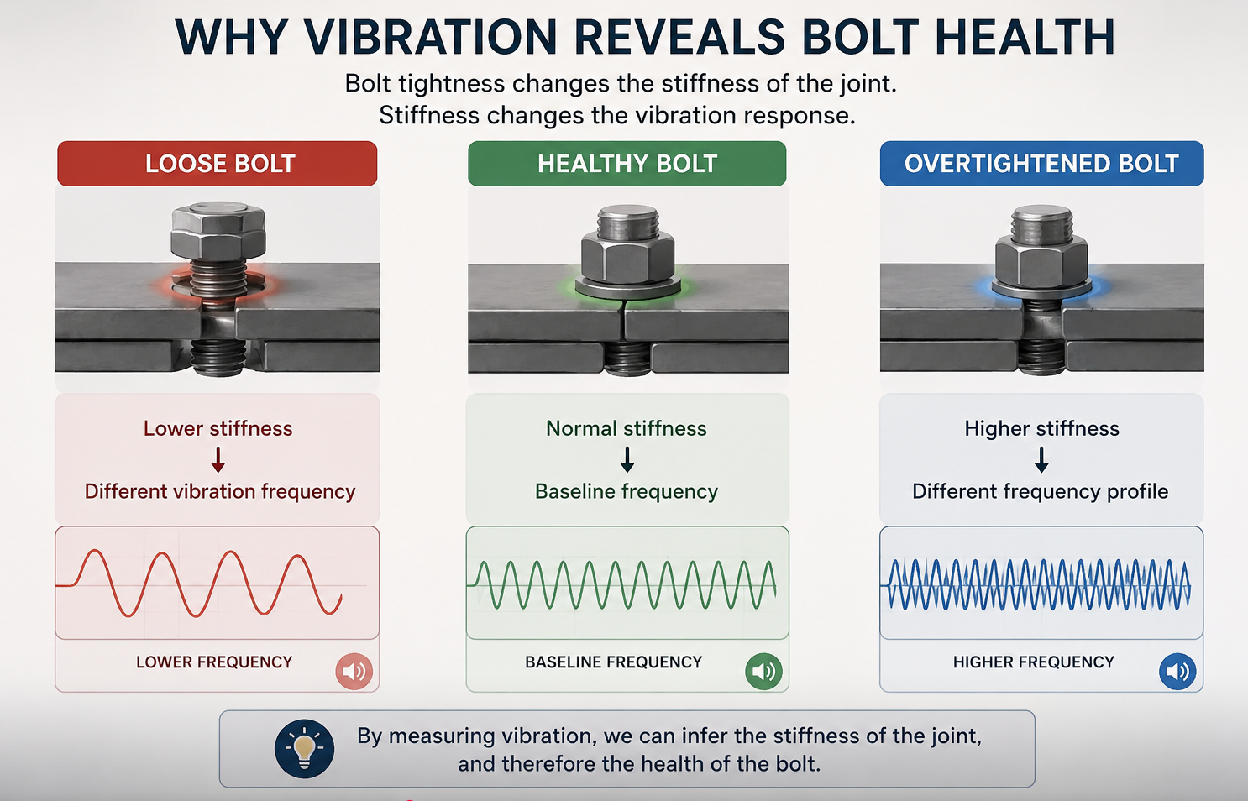
My Solution
-Accelerometers attached to each bolt on a fishplate.
-These accelerometers to detect the vibration of the bolts
-Data sent to control room of the station
-Workers dispatched directly to the specific loose bolts
-Rather than workers checking every bolt.
High Level Steps
Notes:
So here's my idea. Instead of sending people to walk the track, let the trains inspect it themselves. I mount a vibration sensor under an existing train. Every time it rolls over a joint, the sensor feels the vibration, a small AI model decides if the joint is healthy, loose, or over-stressed, and a GPS tags exactly where it is. No new infrastructure, no new trains — every normal run becomes an inspection.

Slide 7
Manual vs Rail-Guard
 | Manual — today | Rail-Guard
Maintenance | Regular Maintenance | Predictive Maintenance
Effectiveness | Not Optimal | Optimal Approach
Over-tightening | Undetectable | Detected
Worker's role | Searching for the loose bolts | Tightening the loose bolts
Notes:
So why is this better than what we do now? Today, you tap every bolt — with my system, you go only to the flagged ones. Today, one person covers a few kilometres on foot — with my system, a single train run covers the whole line. Over-tightening goes from undetectable to detected. And the worker spends his time fixing problems, not searching for them.

Slide 8
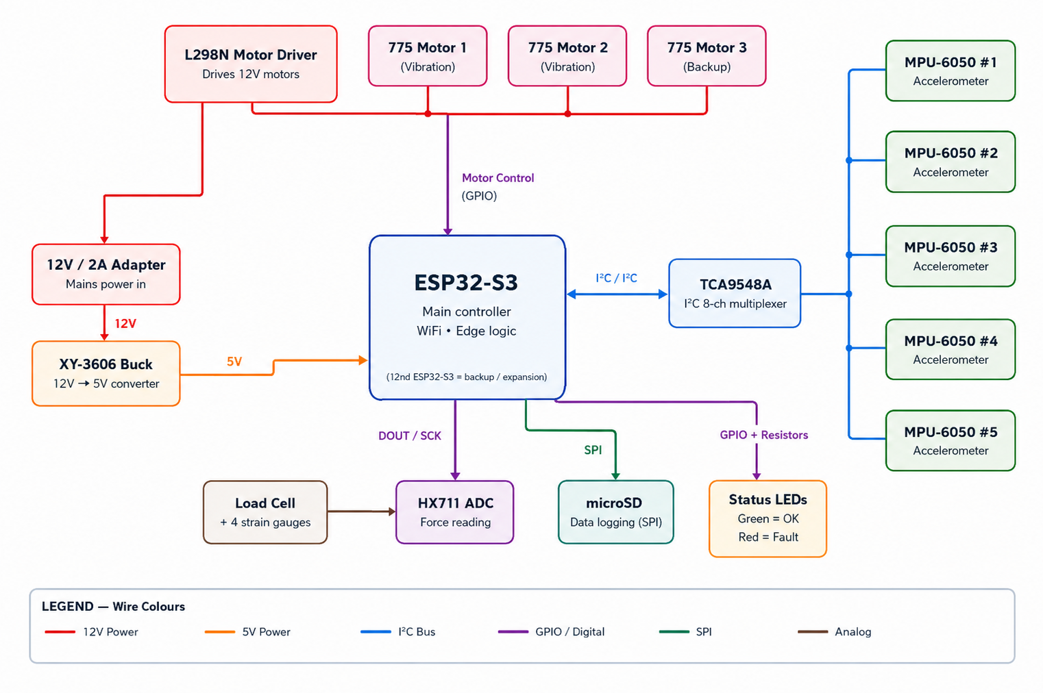
Proving it on a Model Track
ESP32-S3 controller (WiFi built in)
5 accelerometers — one per joint — via an I²C multiplexer
Load cell measures real bolt force (the over-tightening case)
Vibration motors simulate passing trains
Green / red LEDs + live WiFi dashboard
A scaled prototype of the real train-mounted concept.
Notes:
Now, I obviously can't put this on a real train yet — so I'm building a scaled model to prove the concept. This is my wiring. An ESP32 microcontroller is the brain. Five accelerometers, one per joint on my model track, connect through a multiplexer so they share one bus. A load cell measures the actual clamping force, which is how I demonstrate the over-tightening case. Vibration motors shake the track to simulate a passing train, and green and red LEDs plus a WiFi dashboard show each joint's status live.

Slide 9
Thank you
Sources: Indian Railways route length — Wikipedia / official data 2024 · Keyman walking distance — TrackoBit, Lystloc; IR Permanent Way Manual · Hazara Express — Dawn, 2023 · Kavaraipettai — The Week, 2024 · Surat — Deccan Herald, 2024
Notes:
That's Rail-Guard — turning every train into a track inspector, and turning a blind, exhausting job into a targeted one. Thank you — I'd be happy to take any questions.

